Slide 1
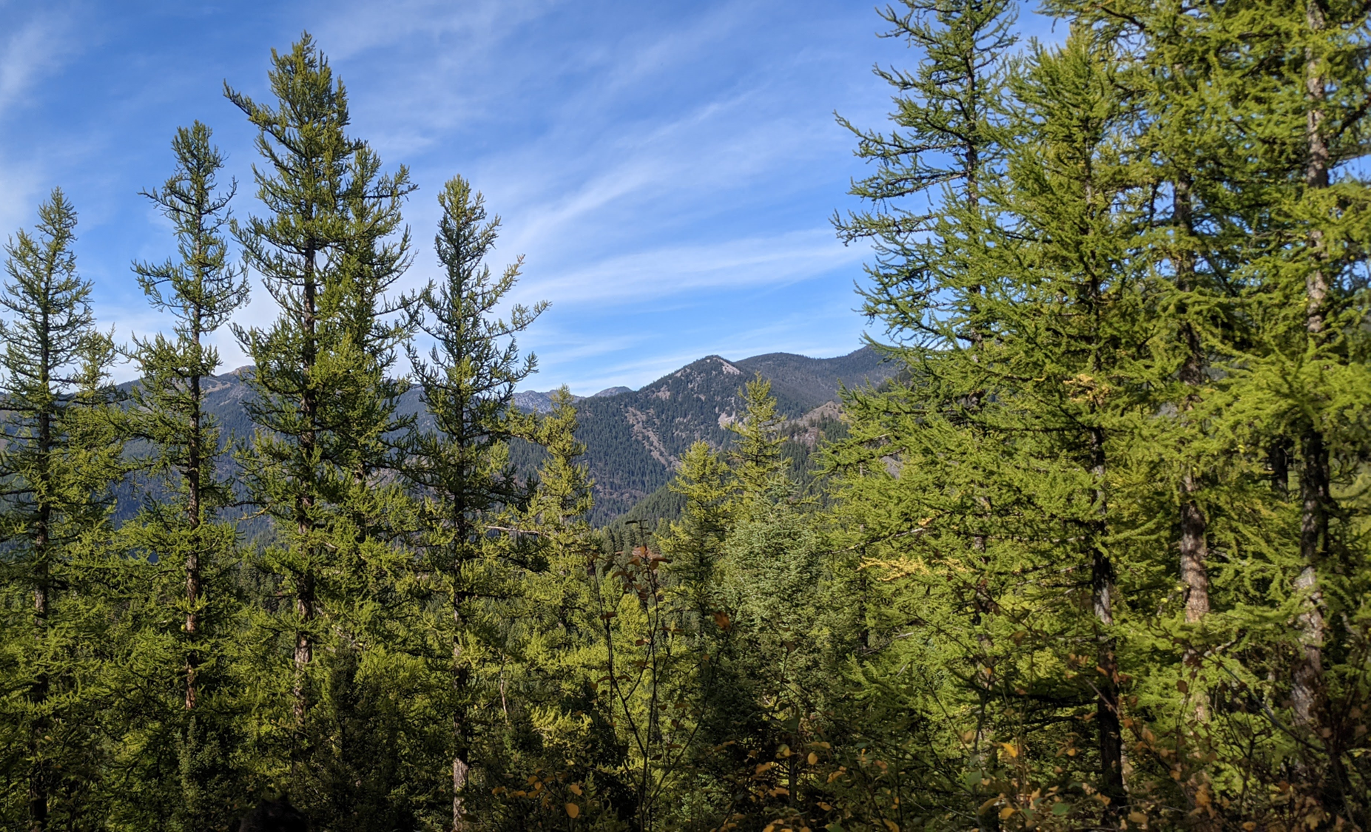


Evaluating the effects of forest community composition on western larch growth
Christian Mercado
(Advisor: David Affleck)
University of Montana, Missoula, MT, USA
Notes:
<intro>

Slide 2
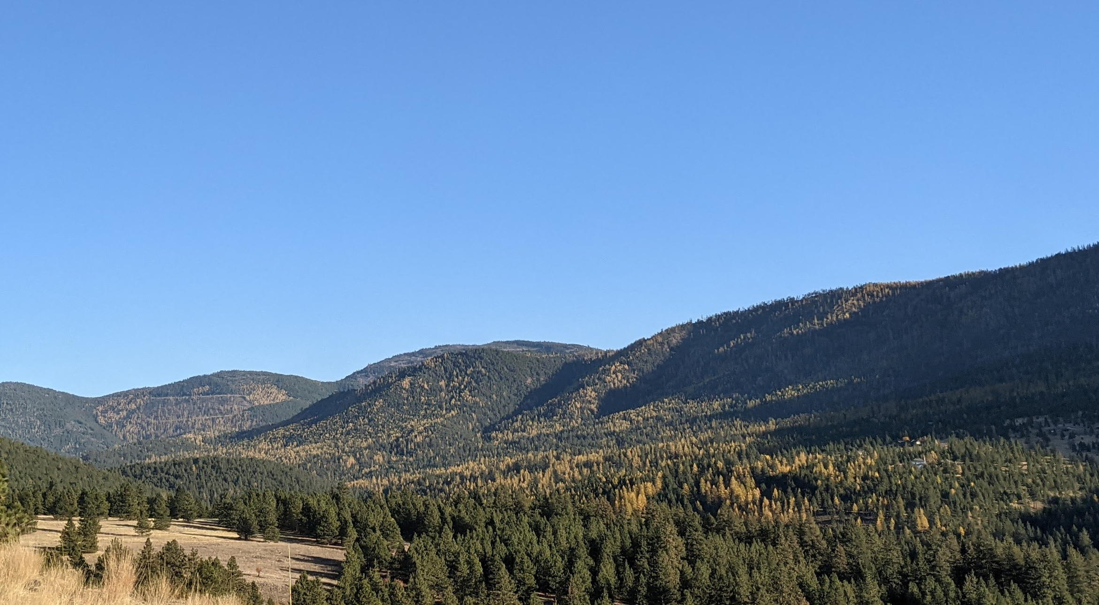
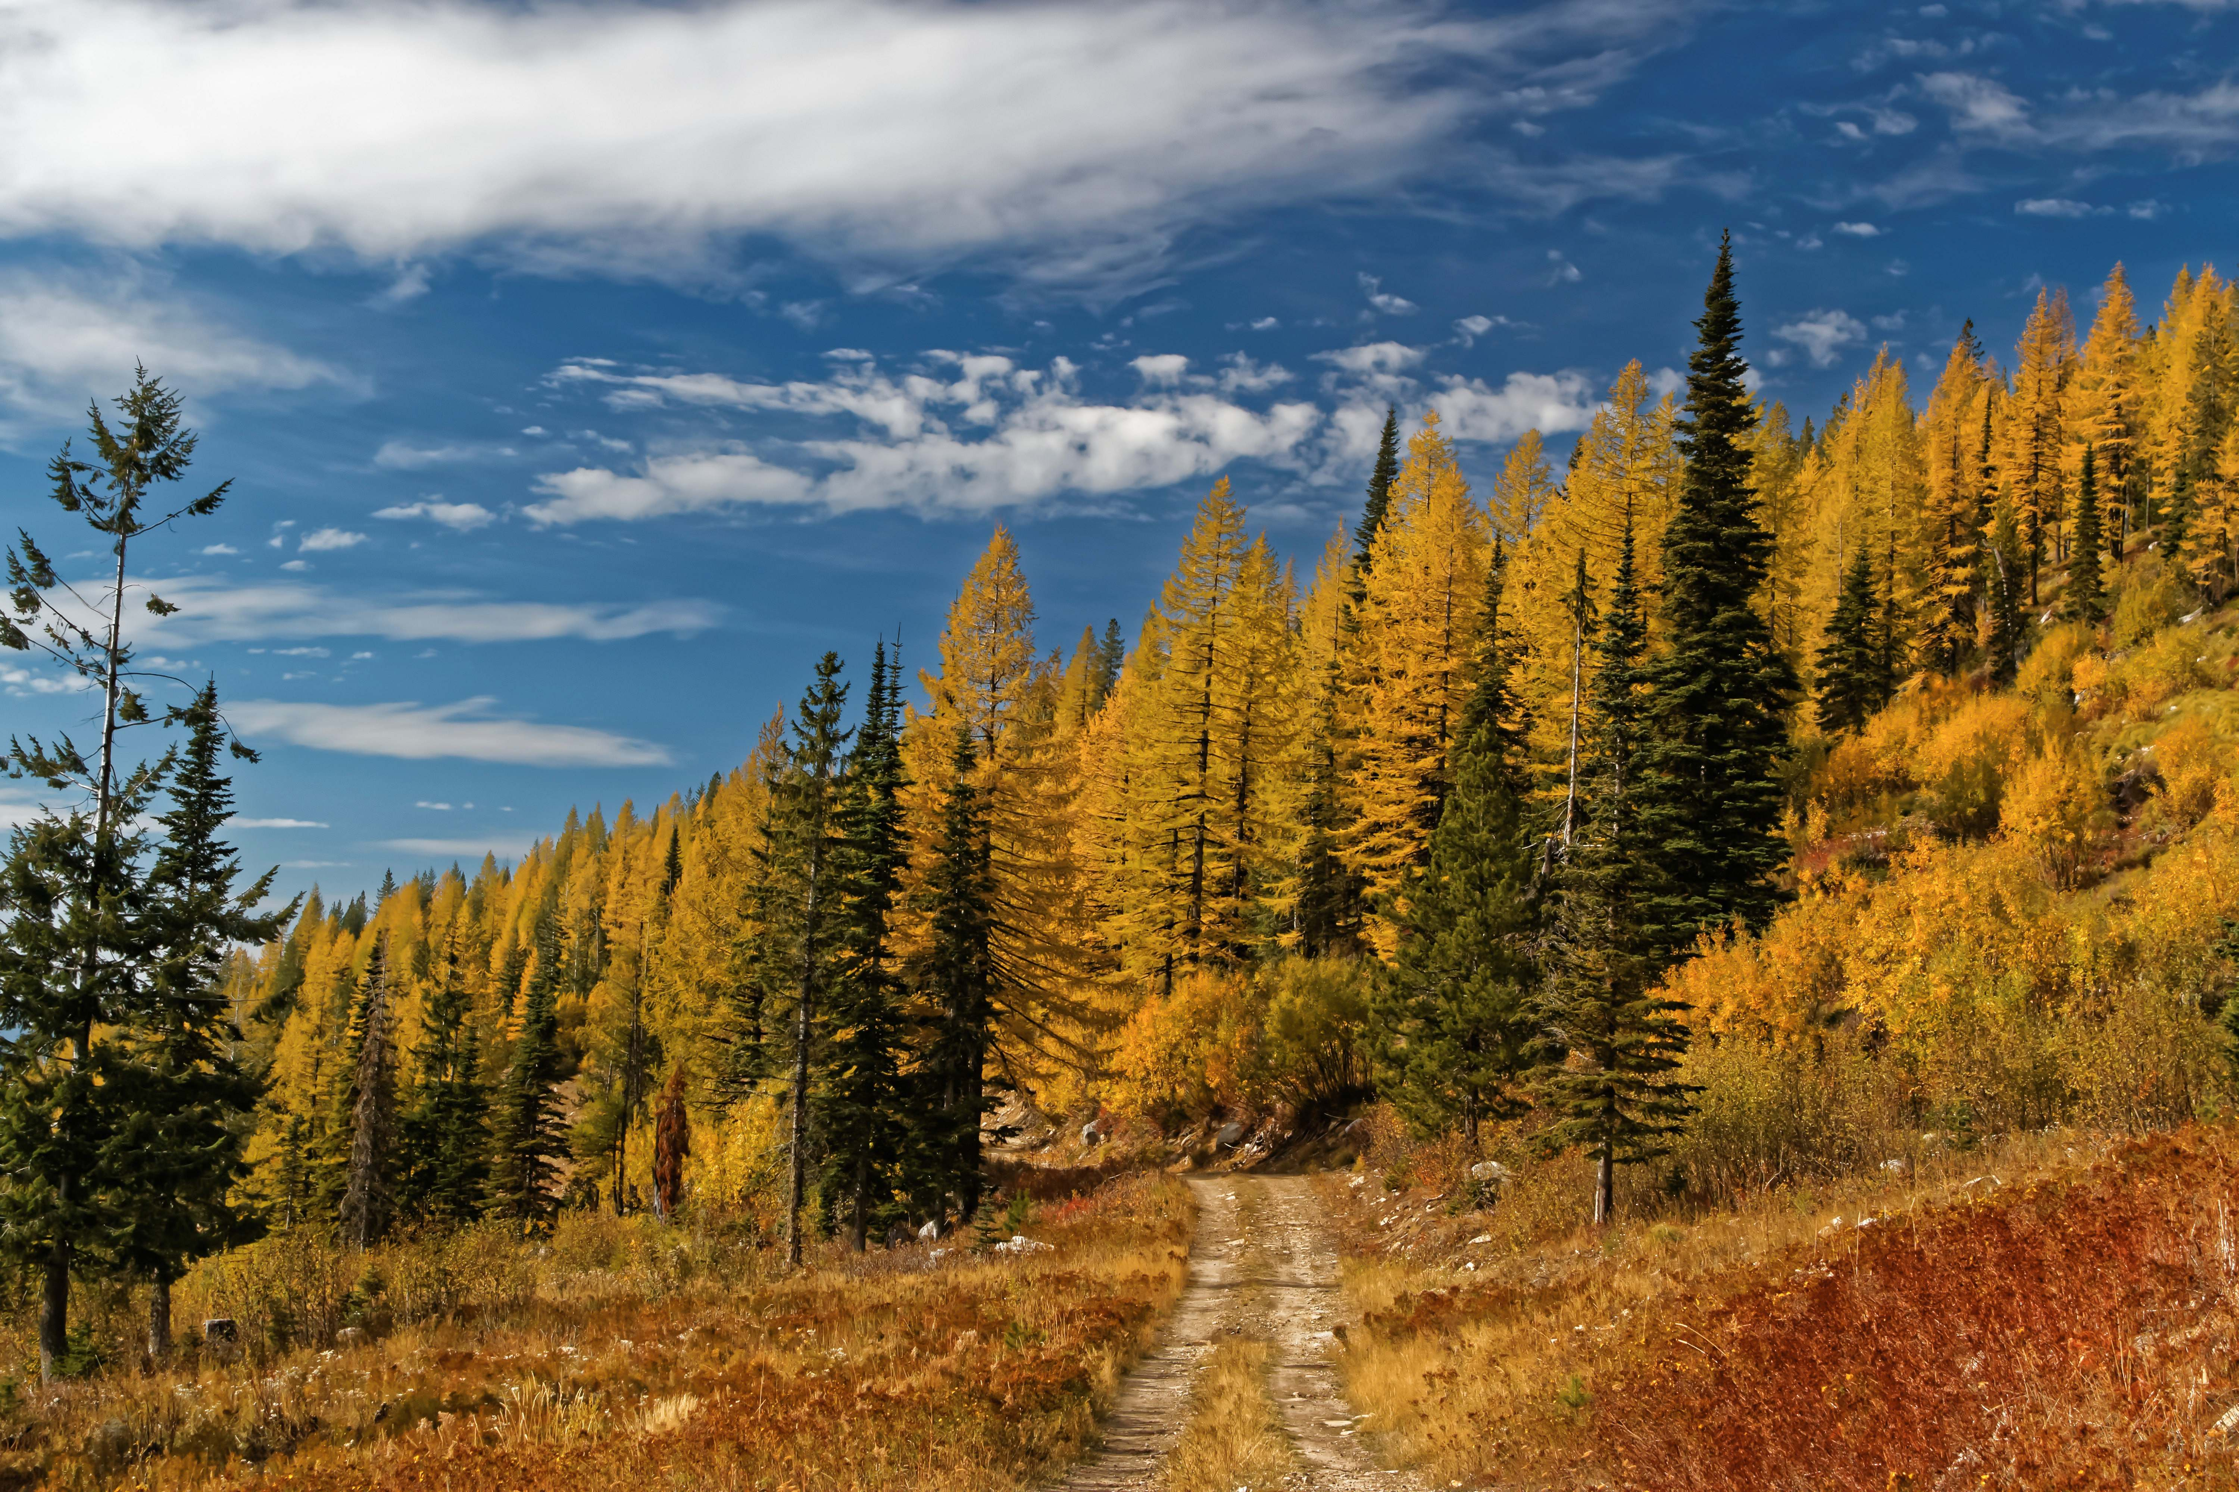
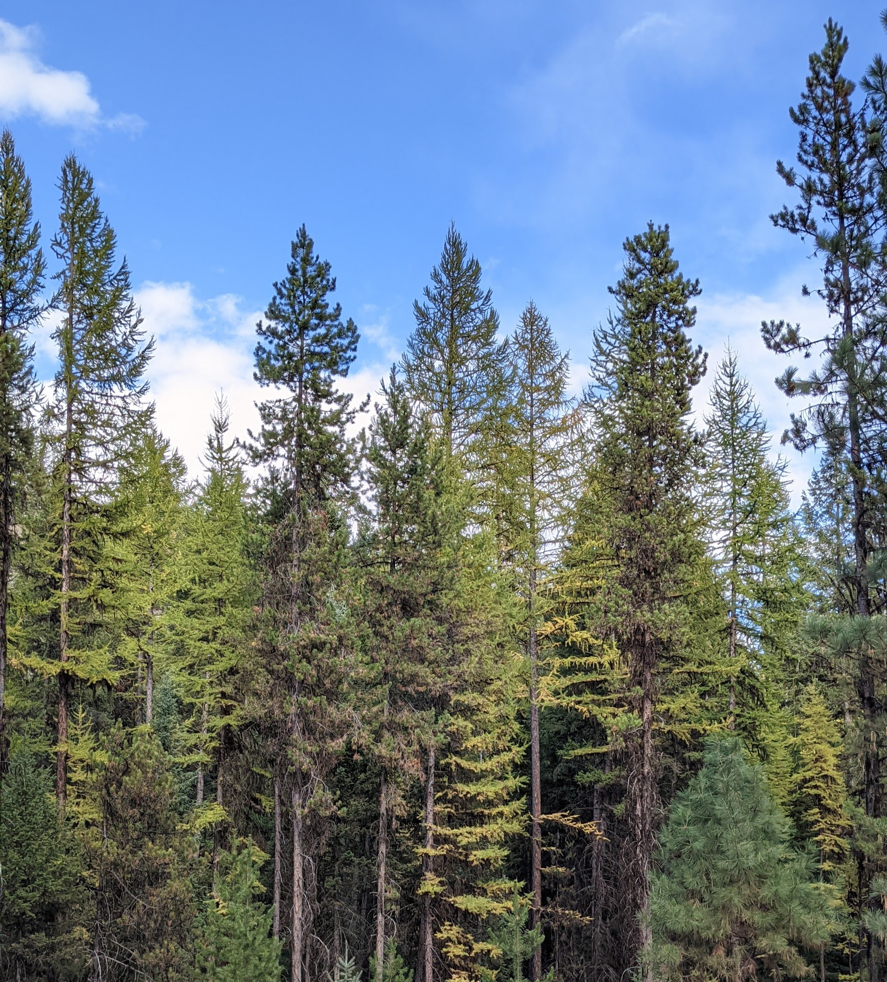
Larix occidentalis – Western larch
Notes:
Western larch (Larix occidentalis) is a deciduous conifer that grows almost exclusively within the inland northwestern region of North America. It is akin to Larix laricina, or eastern larch, however unlike its eastern counterpart, western larch holds considerable timber value. It generally grows tall and straight and can grow to large diameters with heights well over 100 feet.
In each of these photos, larch is revealed by a golden-yellow color. It naturally occurs across a range of forest species community compositions: sometimes as a minor component of a forest like in the left photo, all the way to pure stands, like in the photo on the right.
It is also very intolerant of shade, has fire-resistant and resilient properties, and grows in subalpine environments, establishing well in mineral soil post-disturbance.
Recent research has shown that forest species composition, or species-mixing, can impact the growth of trees and stand yield, but until now, no such research has evaluated the impacts of species composition on the growth of western larch.
Various models, such as those in FVS, have characterized how western larch grows, however, these models don’t explicitly account for species mixture

Slide 3
Objectives
Does species composition impact western larch growth?
What variable best captures this effect?
Notes:
The objectives of this research were:
To identify whether community species composition impacts the growth of western larch after accounting for other influential factors
AND to determine how a species composition effect is best characterized

Slide 4
Objectives
Does species composition influence western larch growth?
Species composition had a minor impact on growth
How can we best characterize this effect?
Both metrics used here displayed a similar impact
Species mixture had an increasing effect on growth
Notes:
Here is a very brief summary of findings to consider as we move forward:
First, after accounting for size, competition, density, and site influences, there was a minor effect of composition on western larch growth
I used two different metrics to capture a community species composition effect – one was a relative abundance weighted by species identity; the other was a relative abundance weighted by shade-tolerance. I’ll describe these a bit more later on.
Both metrics used expressed a similar minor impact on western larch growth
As mixture decreased, the effect that it had on growth also decreased,
in other words, the growth of larch was impacted more when it was growing in more diverse communities.
With these things in mind, I’ll show you how I got to these findings.

Slide 5
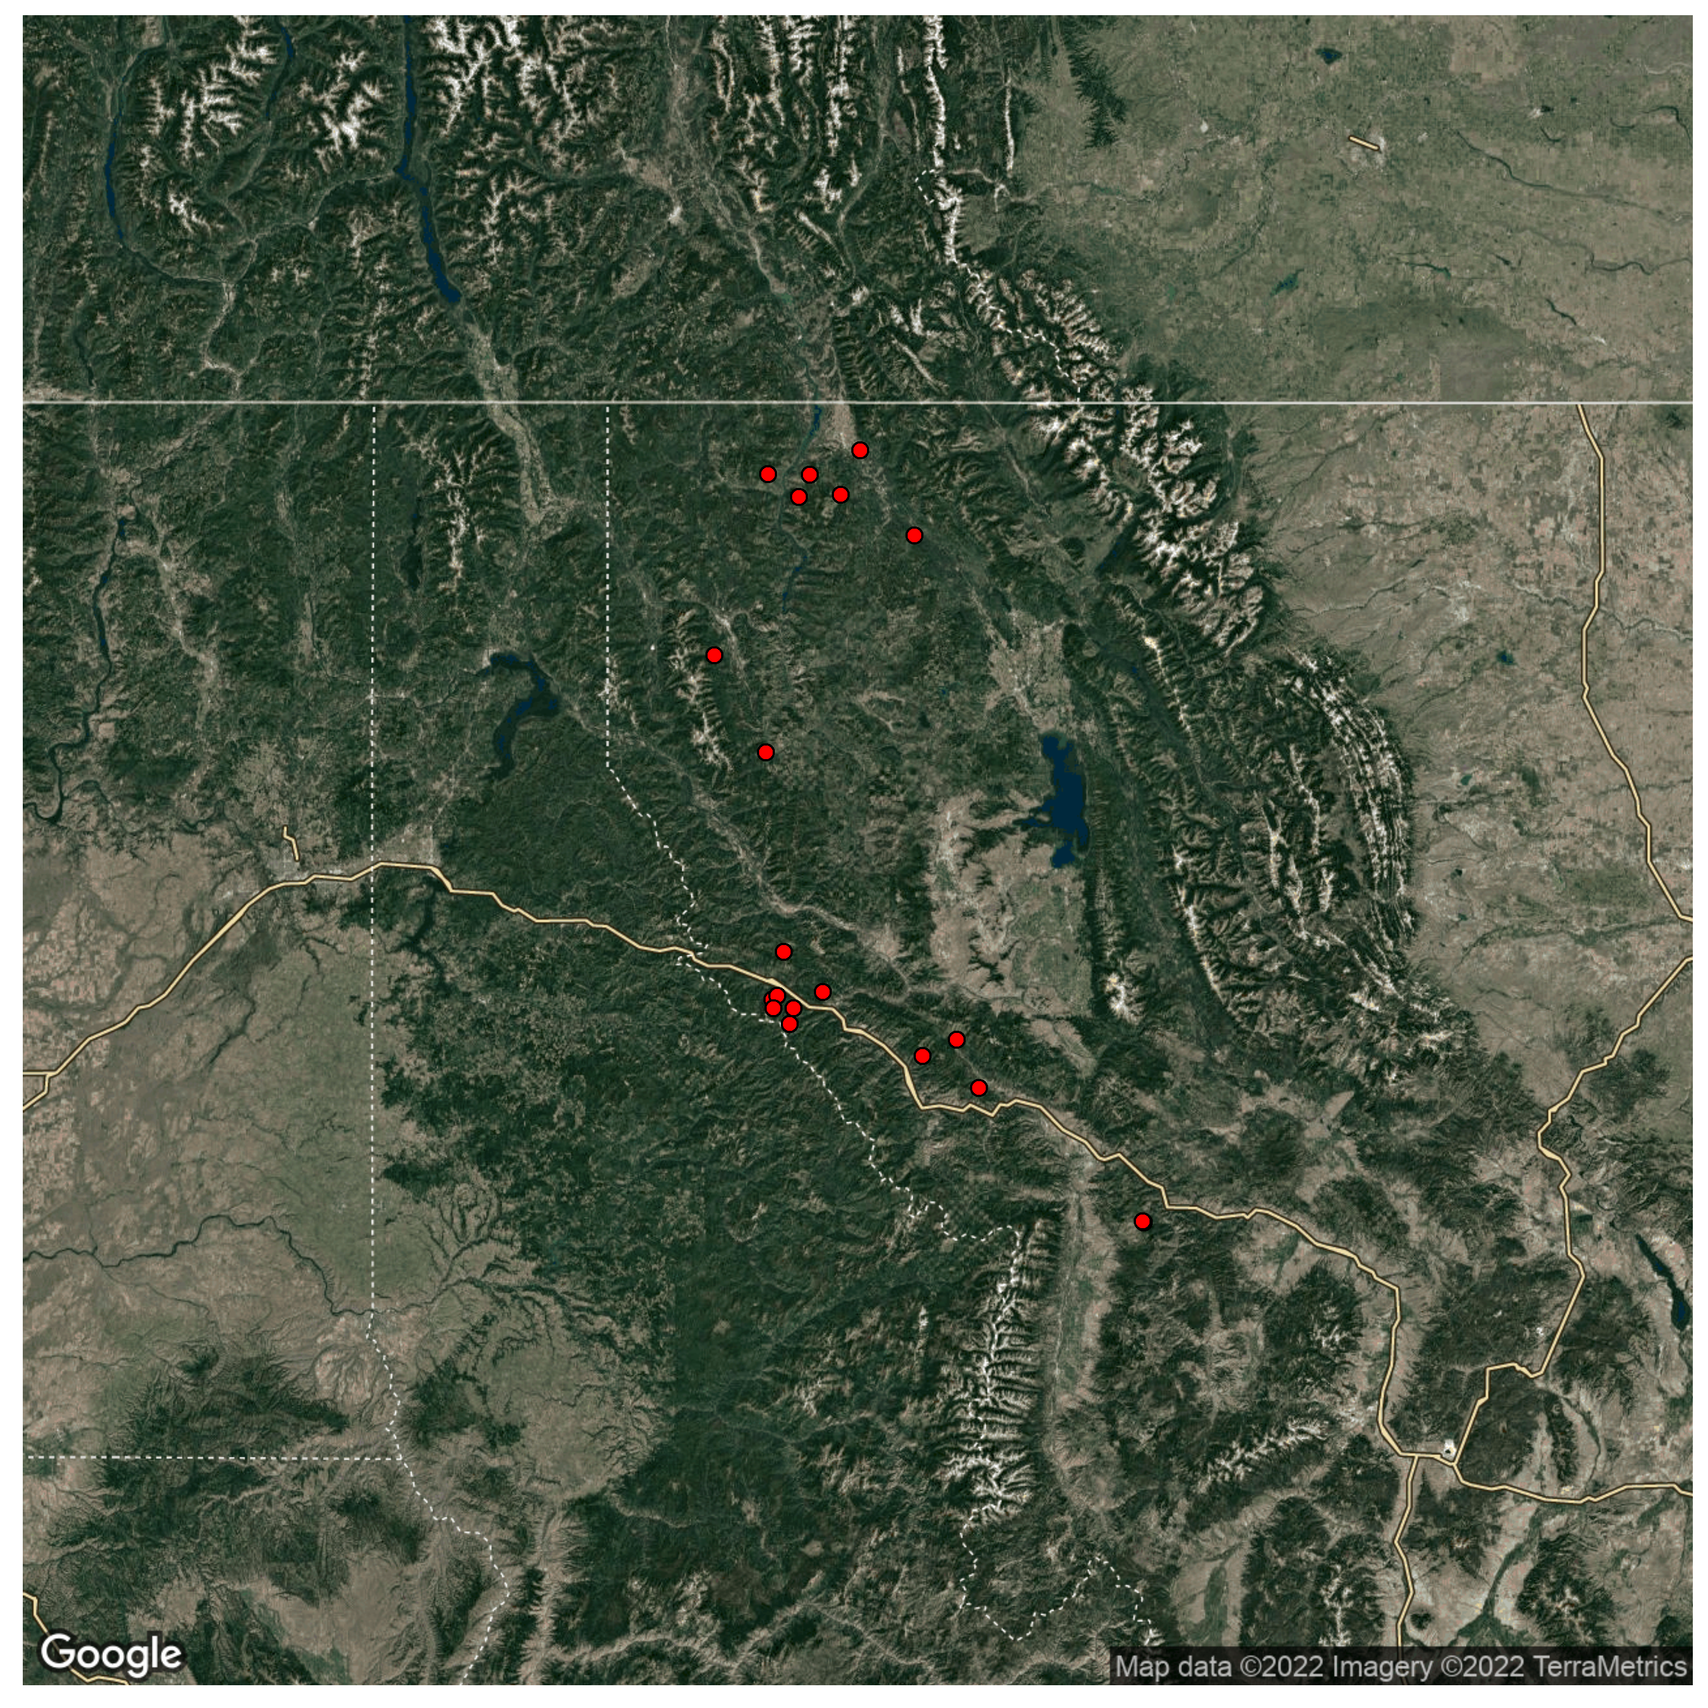
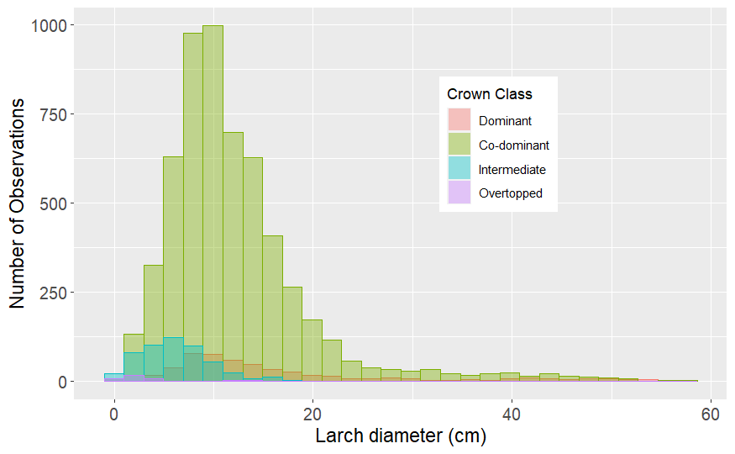
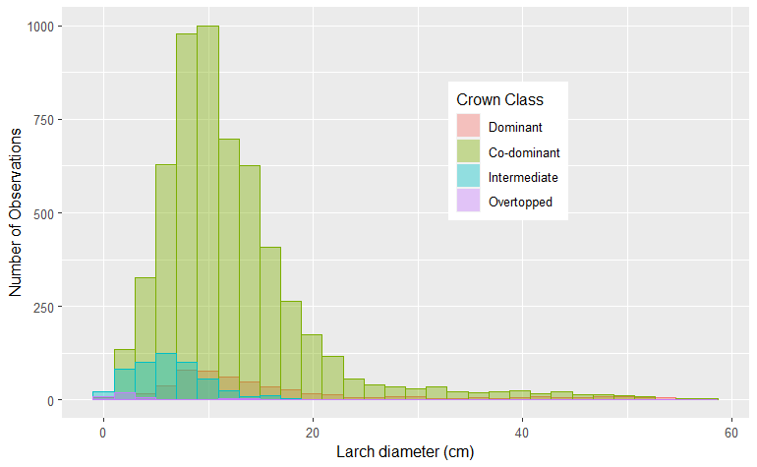
Methods
Developed growth model using GAMM
18 stands on 2 National Forests in Montana
6,845 observations across 2,381 individual larch over ~40 yrs.
Canada
USA
Montana
Washington
Idaho
Notes:
Using a long-term data set which consists of repeat measurements across 18 forest stands in northwestern Montana, a generalized additive mixed model was developed to estimate the growth of western larch.
For these data, trees were tagged and measured about 40 years ago, and subsequent remeasurements on the same trees (and new trees) were taken at varying increments of time since then.
The map here shows the rough locations of study areas used, where each dot represents a stand. Site conditions like slope, aspect, and elevation were variable across stands in the data set.
The figure on the right is a histogram of western larch diameter at breast height (or DBH), where observations are color-coded by tree crown class.
As you can see, tree size varied in DBH between 0 and 60 cm. and most observations were of Co-dominant trees (shown in green), and the least observations were of overtopped trees (shown by the very small purple bins), with a handful of observations of dominant and intermediate trees, shown by red and blue, respectively.
Since western larch is intolerant of shade and considered a pioneer species, it isn’t too surprising that it holds a relatively dominant position in communities that it grows in.
In total, the model was informed by around sixty-eight-hundred growth increments, which were recorded on about twenty-four-hundred individual larch trees.
From here, I’ll show you some of the resulting model-fitted relationships.

Slide 6
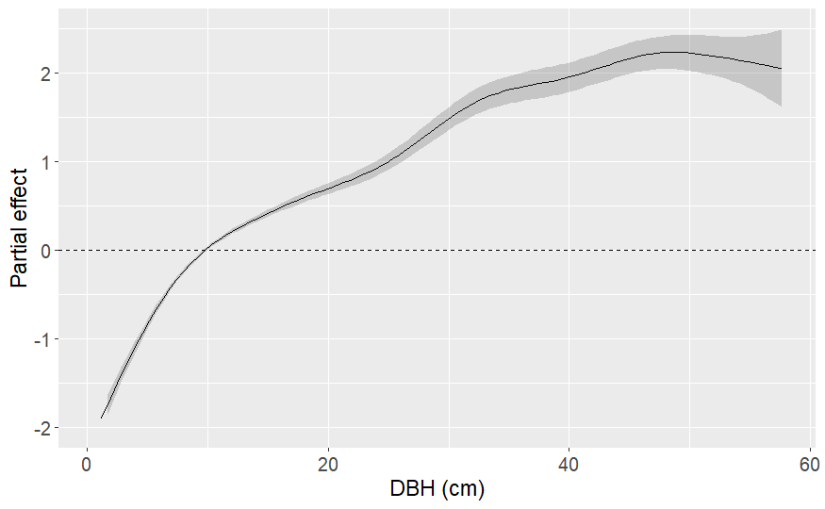
Variable | RMSE (cm²/year) | Deviance Explained
Size | 5.65 | 30.79%
Notes:
The model selection process used here involved accounting for variation by selecting variables based on the following groups: tree size, tree and stand competition and density, and site conditions before evaluating the effects of species composition. This, and each subsequent figure I’ll show displays a relationship where all other variables are held constant. The further from the horizontal-dashed line, the greater the effect the predictor variable has on western larch growth, positive being above the dashed line and negative below.
Additionally, the y-axis on these figures shows the partial effect that the predictor has on the response. This means that for a given value of x, the estimated growth of larch will vary by the effect displayed – so let’s look at the impacts some variables.
Here we see a figure of the partial effect on growth varying by tree size, which was represented by tree DBH in the final model. The shape of this relationship is similar to the results of other growth models, such as the diameter growth model used in FVS.
DBH on its own showed the largest influence on growth compared to all other variables in any group, so it will appear on each of the subsequent slides to provide perspective.
The table here shows root-mean-squared-error values, or RMSE in square-centimeters per year in growth, where values closer to zero represent a higher degree of model accuracy. At the far right is explained deviance, which essentially represents how well the model fits the data. Larger values of explained deviance indicate better model fit.
So, we see here that with DBH alone, the model is not particularly accurate and doesn’t fit particularly well.

Slide 7
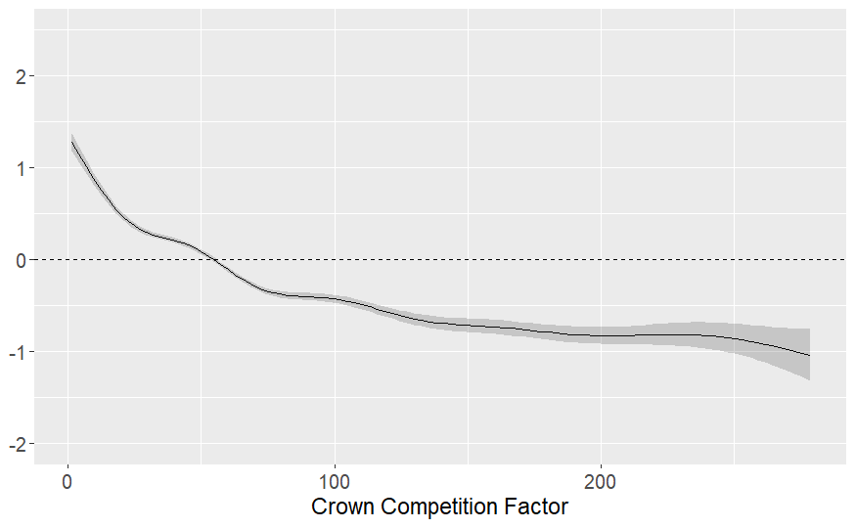
Variable | RMSE (cm²/year) | Deviance Explained
Size | 5.65 | 30.79%
Size + C/D | 4.23 | 62.97%
Notes:
In the competition and density group of variables, Crown competition factor, basal area larger than the subject, and crown ratio were selected in the final model.
Crown competition factor’s effect is shown by the figure on the right. Lower values here show a positive effect on tree growth, and higher values show a decreasing impact on growth. The degree of its effect is a bit smaller than the effect of DBH.
Competition and density variables together improved model accuracy and fit, as seen in the table

Slide 8
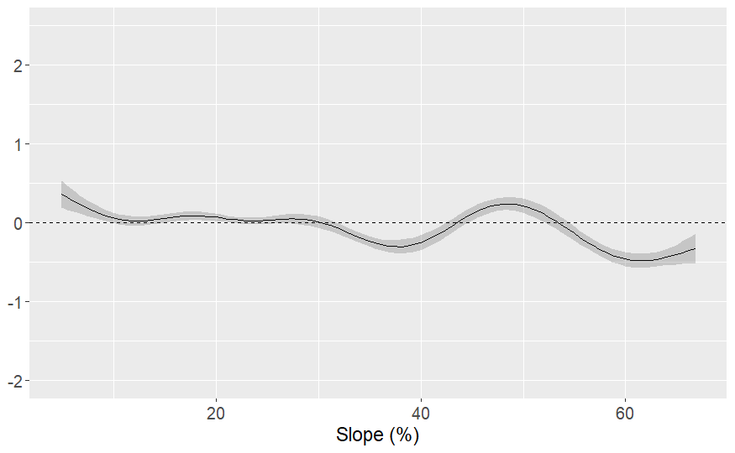
Variable | RMSE (cm²/year) | Deviance Explained
Size | 5.65 | 30.79%
Size + C/D | 4.23 | 62.97%
Size + C/D + Site | 4.07 | 67.00%
Notes:
Slope and aspect together accounted were selected to represent site conditions in the final model.
The slope effect curve is shown here on the right, and clearly has an overall smaller impact on tree growth than what we’ve seen so far.
Notice how the effect is somewhat variable across the range of slope.
This is likely due to clustering in the data set, where data are grouped together within stands and plots, so various trees can share values of slope across the data set and can pull the curve up or down.
HOWEVER, only 2 site variables were included in the model, and thus were meant to account for all the effects of site on tree growth, so some amount of visual noise in any fitted relationship pertaining to site is to be expected.

Slide 9
Variable | RMSE (cm²/year) | Deviance Explained
Size | 5.65 | 30.79%
Size + C/D | 4.23 | 62.97%
Size + C/D + Site | 4.07 | 67.00%
Full model (w/ RE) | 3.34 | 83.97%
Notes:
And for the sake of continuity, the improvements on RMSE and Deviance explained by adding tree-level-random effects are included in the table below. This represents the base model with which species composition terms were considered.
Now I’ll show some of the species-composition results.

Slide 10
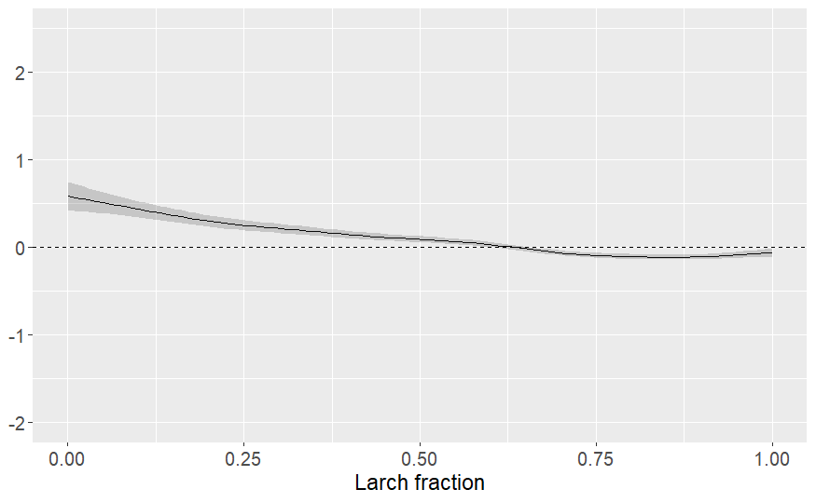
Variable | RMSE (cm²/year) | Deviance Explained
Full model (w/ RE) | 3.341 | 83.97%
.. + larch fraction | 3.328 | 84.25%
Notes:
The curve on the right shows a ‘larch fraction’ variable, which represents the community-level proportion of basal area taken up by western larch
So smaller values here indicate that a larch is surrounded by trees of other species, whereas larger values characterize a community with more western larch.
Here we see a relatively small effect overall This fitted relationship appears relatively stable, and we see an increase in western larch growth when larch is mixed with other species, and as a community becomes more homogeneous we see less effect or slightly negative effect on growth, given that other variables remain constant.
However, when this variable was added to the model, the increase in model accuracy (shown by a smaller RMSE) was very modest, and likewise the increase in explained deviance (or model fit) with this term was somewhat marginal.

Slide 11
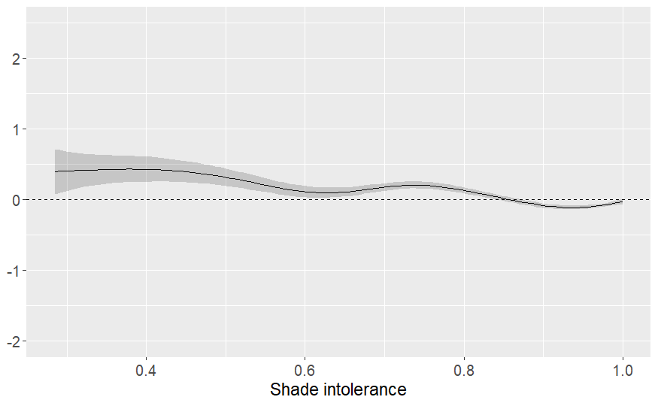
Variable | RMSE (cm²/year) | Deviance Explained
Full model (w/ RE) | 3.341 | 83.97%
.. + larch fraction | 3.328 | 84.25%
.. + shade intolerance | 3.339 | 84.33%
Notes:
So in this other metric, simply titled ‘shade-intolerance’, instead of weighting abundance by species identity, we weight abundance by a value of species-shade-intolerance scaled between 0 and 1.
In this case, higher values indicate that a community is composed of more shade-intolerant species, like larch and lodgepole pine, and lower values indicate a more shade-tolerant community composed more of douglas-fir, true fir, or spruce, for instance.
With this metric, species identity is not quite as important because shade tolerance is meant to capture how trees interact with light, and thus describes the mixed-species competitive dynamics in a community.
Similar to larch fraction, we see an overall decreasing effect of shade-intolerance on growth as a community becomes more homogenous; when larch is mixed with more shade-tolerant species, there appears to be a positive effect on its growth.
Again, however, the increases in model accuracy and fit were very small, so its relative impact on the overall relationship is small, but not unimportant.

Slide 12
Conclusions
Does species composition influence western larch growth?
Species composition had a minor impact on growth
How can we best characterize this effect?
Both metrics used here displayed a similar impact
Species mixture had an increasing effect on growth
Notes:
So back those conclusions from before – species composition impacted growth where more mixing was associated with more growth in western larch, but after accounting for other factors known to influence growth, the impact of community composition was small.
Thank you for your time and for allowing me the opportunity to present my work to you.
I’ll gladly take a question now if there is time, and feel free to follow up with me later in the open discussion forum or reach out to me directly, via email.
Thanks

Slide 13
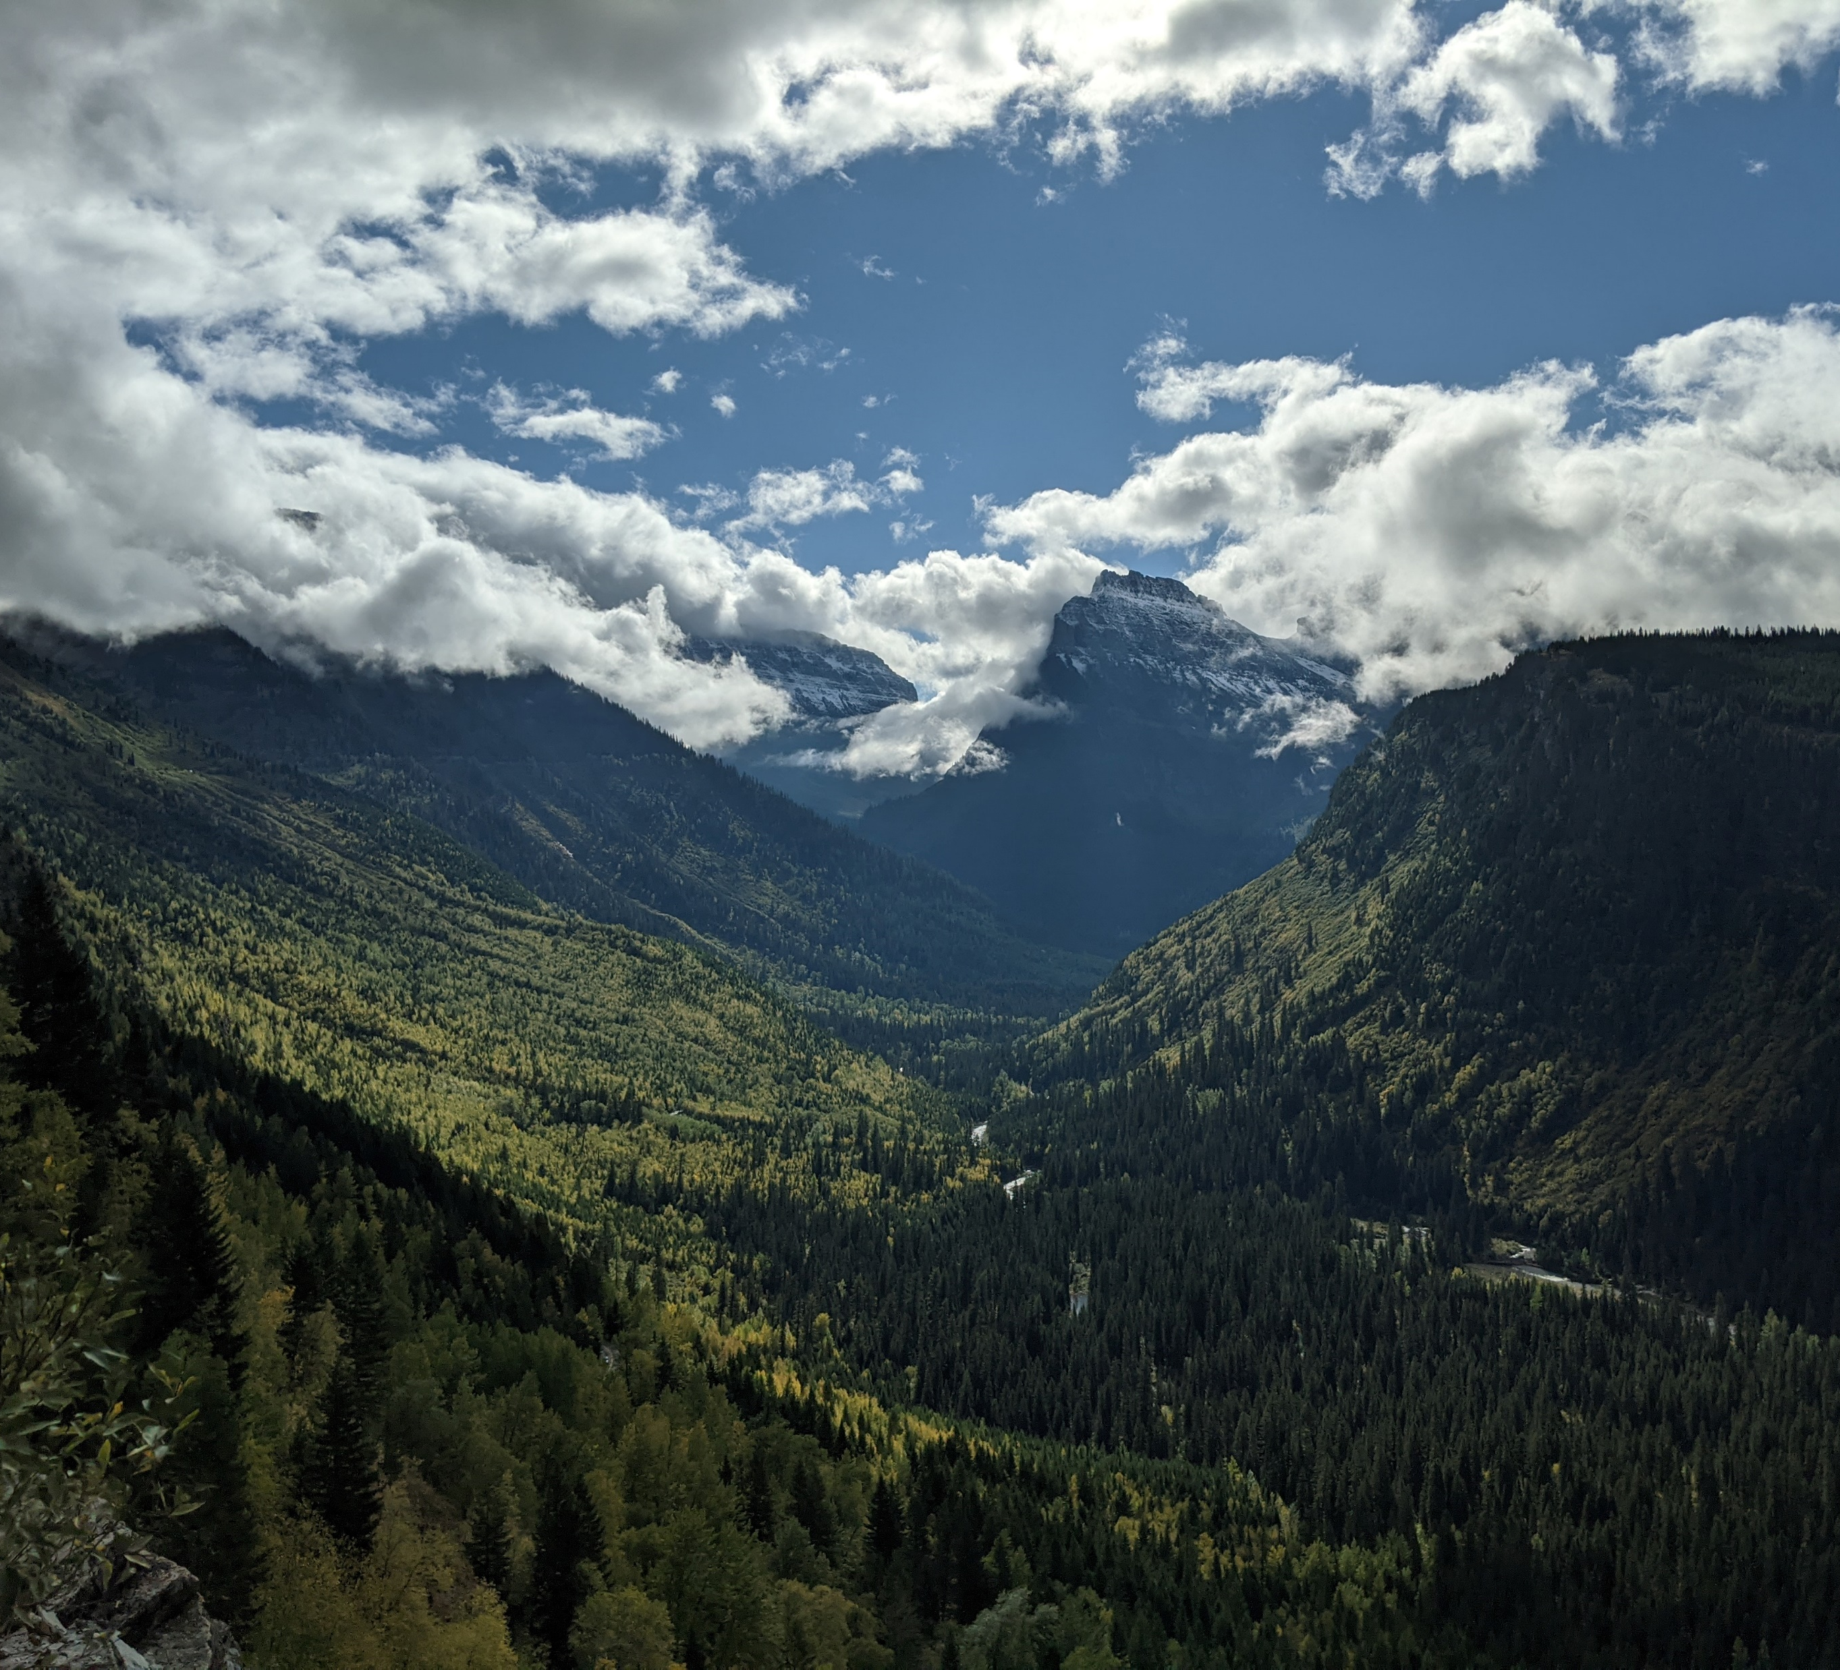
Broader context
Species-mixing can impact tree growth in the intermountain west
Understanding interspecific relationships can aid in mixed-value management goals
As climate impacts species distributions, better understanding of growth dynamics can be helpful for adaptive management
Notes:
So why is this all relevant:
If a species-mixing effect on growth is prevalent across species and communities, it can better inform models and in-turn, prediction and management can be better informed
Since modern management across the intermountain west involves considering different values simultaneously, then better characterizing ecosystem dynamics in mixed-species forests is critical to making informed decisions.
Since western larch only grows across a relatively small area of the west, understanding how it interacts with other species can inform planting regimes, assisted migration efforts, as well as overall conservation-based management in a time where climate is so uncertain.

Slide 14
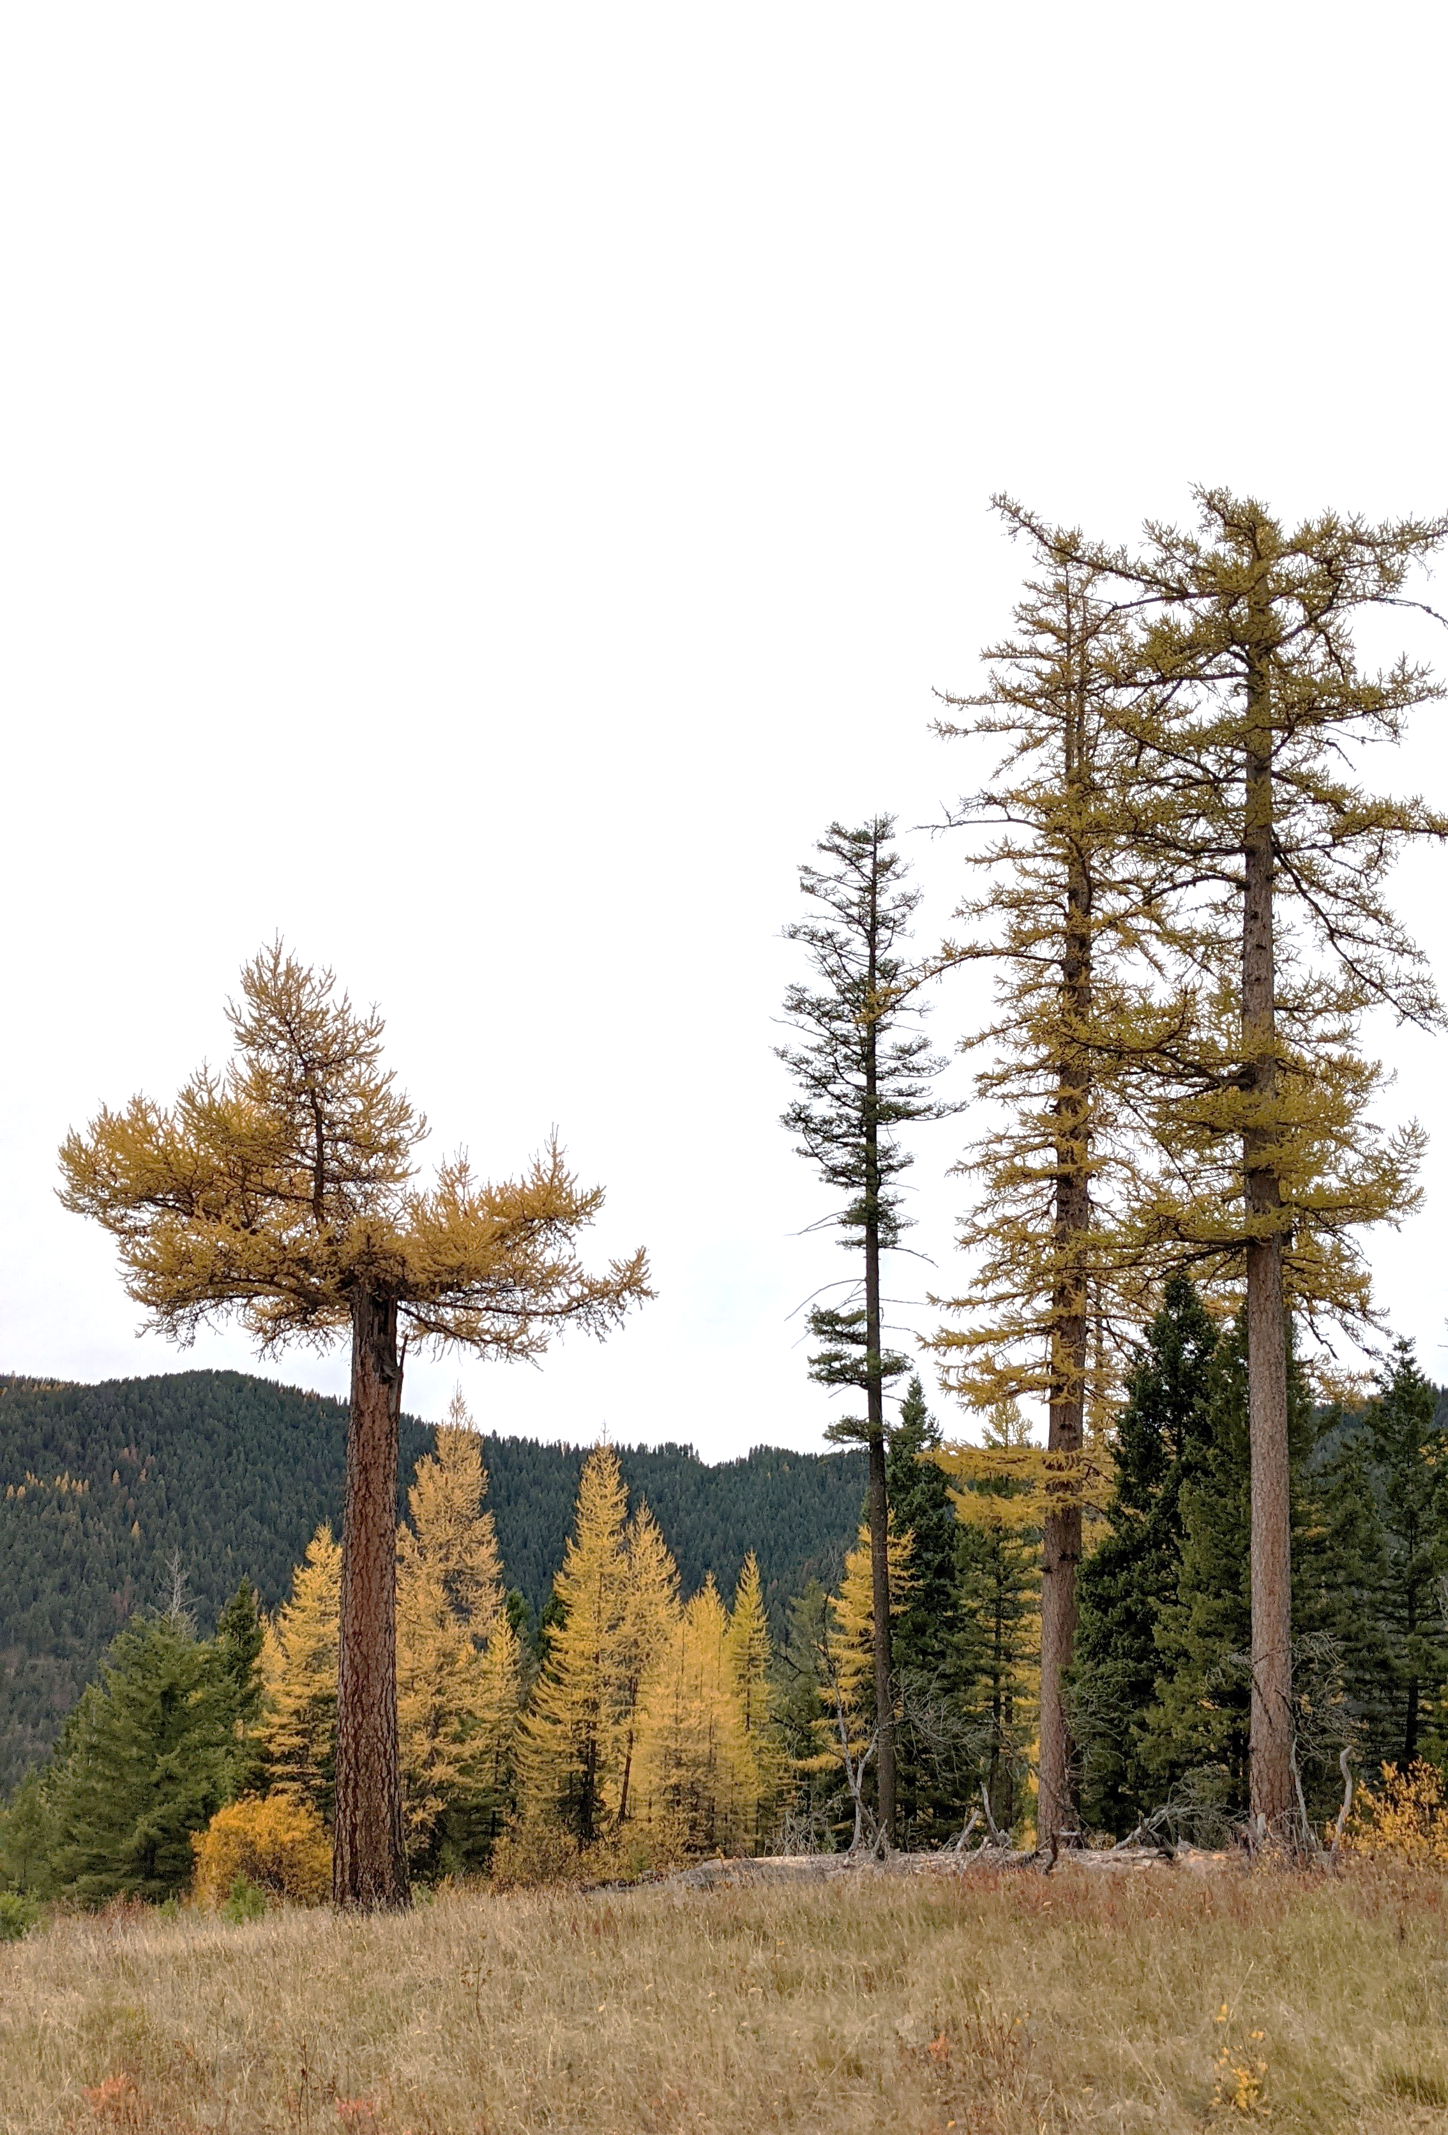
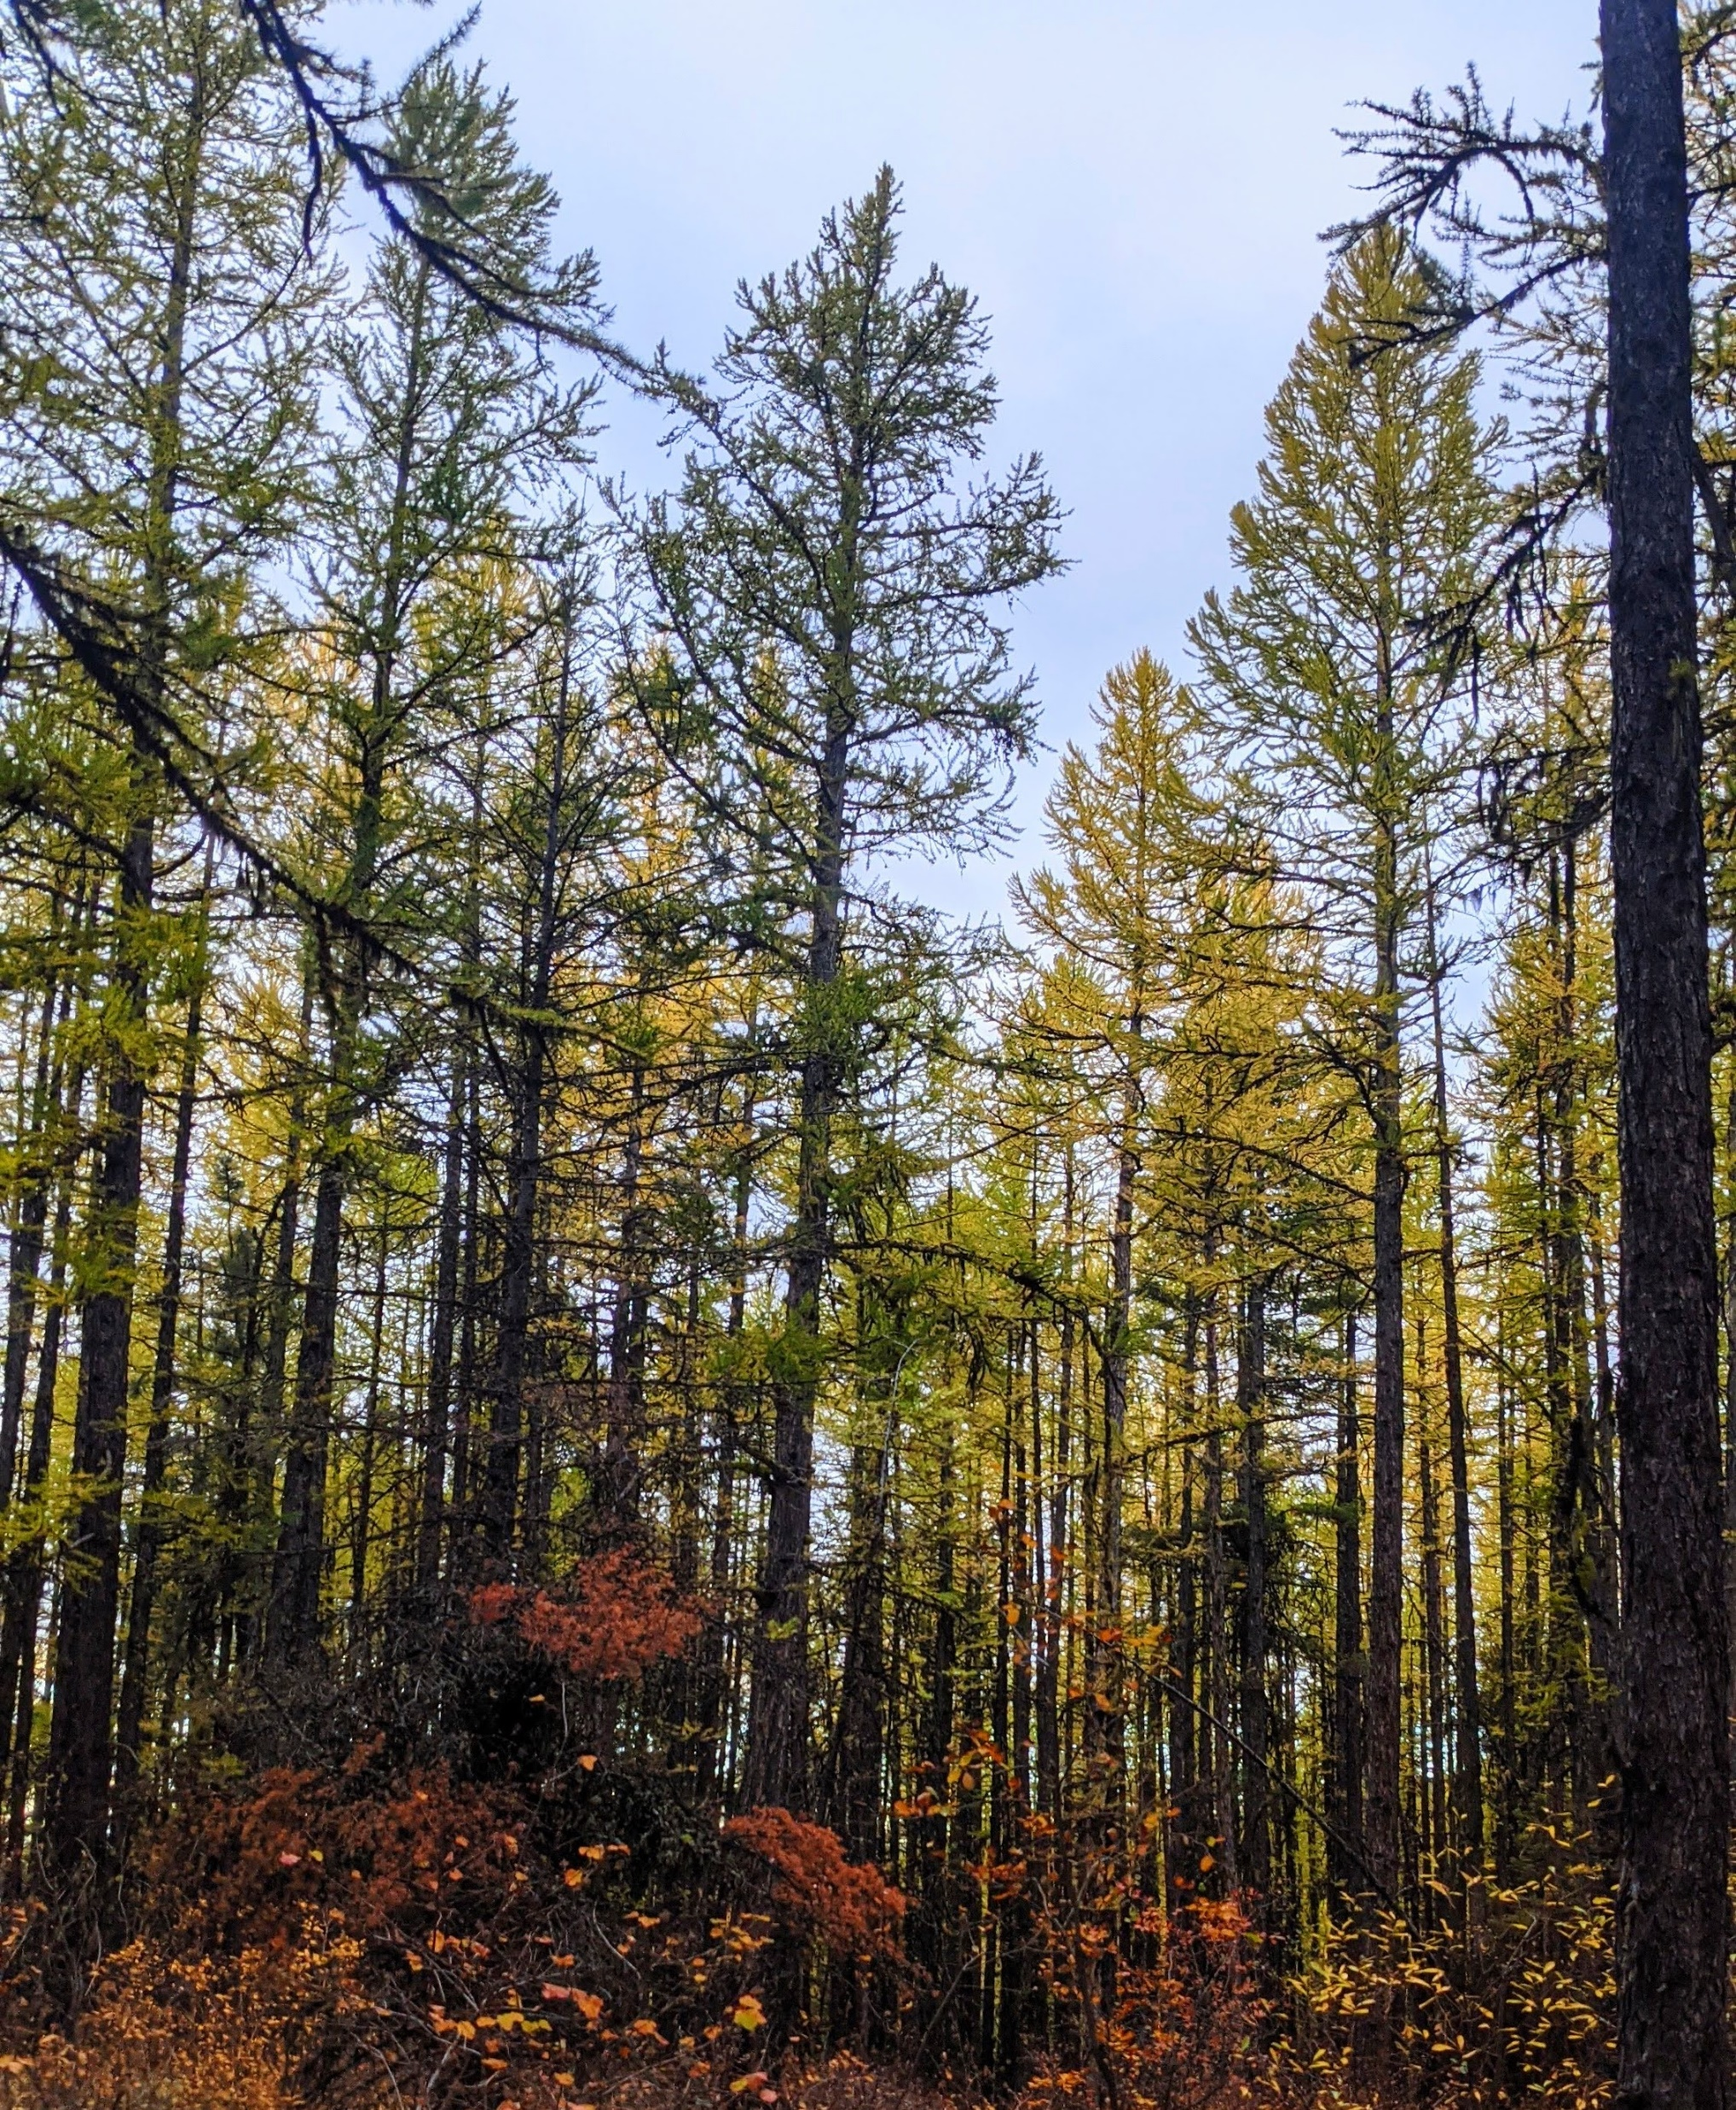
Questions?
Email: christian.mercado@umontana.edu
Notes:
Thank you for your time and for allowing me the opportunity to present my work to you.
I’ll gladly take a question now if there is time, and feel free to follow up with me later in the chatroom, or reach out to me via email.
Thanks

